Slide 1
Upper Mokelumne River Watershed Authority’s Forest Health Program September 4, 2019

Slide 2
Introduction
Presenters
Richard Sykes
Executive Officer
Upper Mokelumne River Watershed Authority
Karen Quidachay
Landmark Environmental, Inc.
Forest Health Program Manager
Upper Mokelumne River Watershed Authority

Slide 3
Introduction
Presentation Topics
Who is UMRWA
UMRWA’s Forest Health Program
Dollars & Acres - 3 years investment in Upper Mokelumne Forest health
Looking ahead

Slide 4
UMRWA Is…..
Snapshot
UMRWA is a Joint Powers Authority formed in 2000 to address mutual regional interests:
Water quality
Water supply
Natural resources
8 member Board of Directors
Supported by two part-time staff, Landmark Environmental, and Member Agency in-kind support
Member Agencies
Alpine County
Alpine Water Agency
Amador County
Amador Water Agency
Calaveras County
Calaveras County Water District
Calaveras PUD
East Bay MUD
Jackson Valley ID

Slide 5
UMRWA Is….

Slide 6
UMRWA Is….
Enhancing the region’s stewardship capacity by:
Collaborating on forest health initiatives ($4M in SNC & USFS watershed investments)
Sponsoring the MAC IRWM Region (awarded $10.1M implementation grants)
Conducting region-level assessments & resource planning (MokeWISE, WARMF)
Leveraging efficiencies (centralized grant functions, proportionate shared costs, enhanced political effect)

Slide 7
UMRWA’s Forest Program
USFS – UMRWA Partnership
Exploratory joint workshop July 2015
Cornerstone CLFR Project funding
Mutual FS – UMRWA interests:
Facilitate federal expenditures in watershed
Leverage federal $ with state $
Exploit UMRWA’s contracting efficiencies
Implement ‘on the ground’ projects asap
Master Stewardship Agreement (May 2016)
Describes partnership goals (fuels reduction, WQ and supply protection, reforestation)
Prioritizes implementation of Cornerstone projects
Basis for Supplemental Project Agreements (SPAs)

Slide 8
UMRWA’s Forest Program
UMRWA’s Role Under the MSA
Maintain planning, management and financial capabilities
Explore project funding opportunities
Work w/USFS to develop project-specific SPAs
Fulfill CEQA requirements for SPA projects
Provide qualified personnel & contractors to implement SPA projects
Manage UMRWA contractors in coordination w/USFS
Annual Cycle of UMRWA Tasks
Hemlock Project: plans/CEQA/grant applications
Field verification/unit flagging
Requests for Proposals
Engaging contractors
Field operations/inspections
Invoicing, contractor payments, reporting
Lessons learned session with Partners

Slide 9
UMRWA’s Forest Program
Key Program Elements
Maintain high-level coordination with Forest Partners
Prioritize UMRWA member funds to facilitate planning and procure funding
Provide 5% preference to local (Amador, Alpine, Calaveras) contractors and service providers
Engage CCC to work on every project
Implement only ACCG-endorsed projects
Conduct contractor workshops to enhance Proposal development

Slide 10
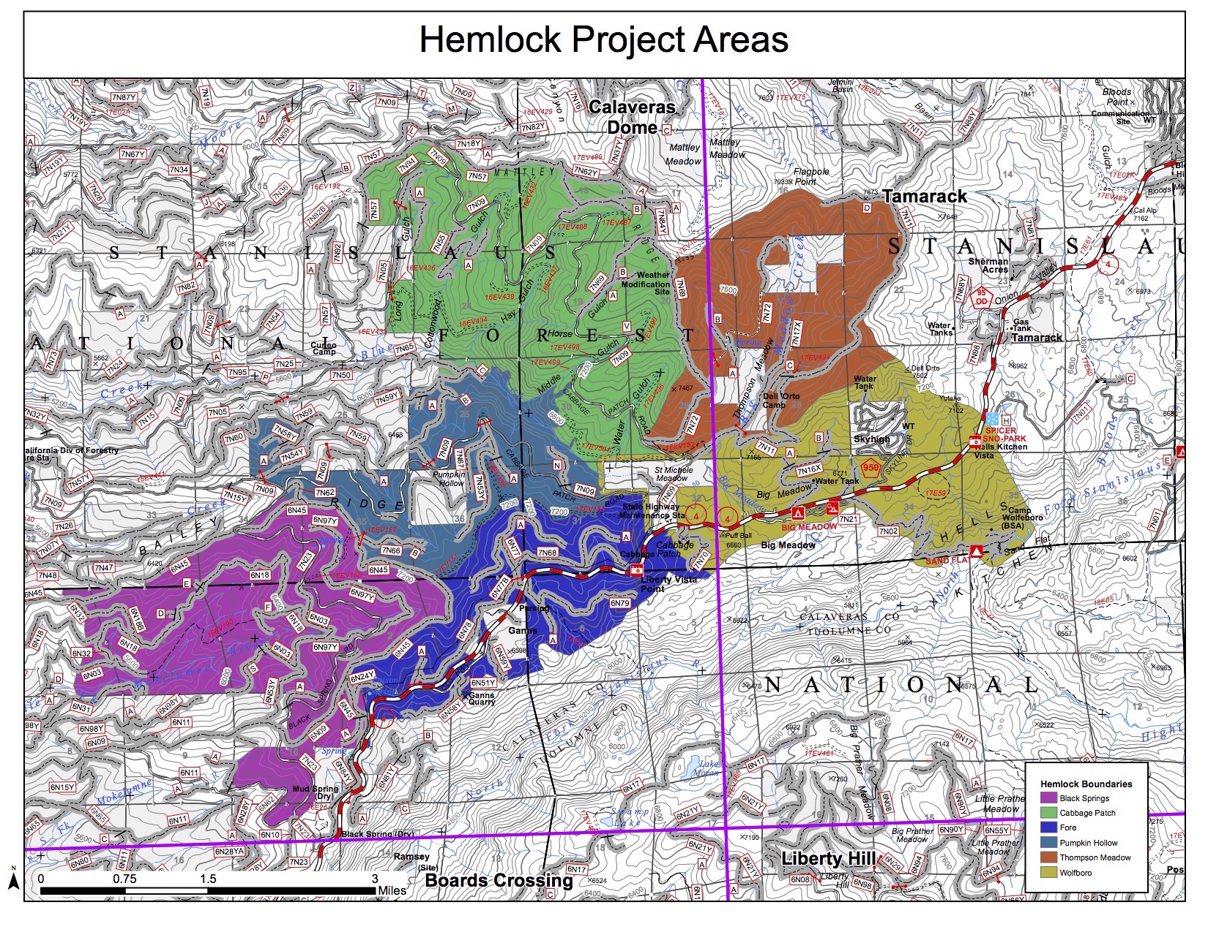
UMRWA’s Forest Program

Slide 11
Dollars & Acres – 3 Years of Forest Investments
UMRWA Managed Hemlock Projects | State & Federal Investment
Pumpkin Hollow – 971 acres (2017 - 2019)
Sierra Nevada Conservancy Proposition 1 grant no. 1 | $ 500,000
USFS Master Stewardship Agreement and Pumpkin SPA | $ 609,841
Pumpkin Hollow Project Total | $ 1,109,841
Cabbage Patch – 1,219 acres (2018 – 2020)
Sierra Nevada Conservancy Proposition 1 grant no. 2 | $ 500,000
USFS Master Stewardship Agreement and Cabbage SPA | $ 736,000
Cabbage Patch Project Total | $ 1,236,000
Black Springs – 1,825 acres (2019 – 2021)
Sierra Nevada Conservancy Proposition 1 grant no. 3 | $ 1,000,000
USFS Master Stewardship Agreement and Black Springs SPA | $ 648,000
Black Springs Project Total | $ 1,648,000
Totals | $3,993,841 4,015 acres

Slide 12
Looking Ahead
Increasing Pace and Scale: Keys to UMRWA’s Capacity
Retain experienced Authority staffing at flexible levels (EO and AO positions)
Retain experienced LEI staffing at flexible levels
Enhance inter-agency efficiencies
Expand pool of in-region qualified, interested and competitive contractors
Streamline seasonal workload variations
Expand mutually beneficial partnerships (MDF, CHIPS, NFWF)
Optimize use of Forestry Interns (ACE - American Conservation Experience, and CalPoly)

Slide 13
Looking Ahead
Pace and Scale: Keys to Increasing Contracting Capacity
Minimize uncertainties/impediments to contractor’s work performance (LOPs, inspection timing, site access, etc.)
Right-size contract units based on contractor survey input
Conduct workshops on UMRWA selection standards and process

Slide 14
Looking Ahead
Pace and Scale: Challenges to Expanding UMRWA’s Forest Program
Overcome USFS staff turn-over and seasonal shortages
Ensure ACCG support for partnership projects
Establish sufficient bid-ready projects to compete for grants
Expand sources for available grant funding
Organize projects in logical units for contracting
Fulfill NEPA and CEQA requirements
Maintain UMRWA organizational depth and flexibility

