Slide 1
MAC Plan Update Mokelumne / Amador / Calaveras Integrated Regional Water Management Plan Update
RPC Meeting No. 2
May 26, 2010
1:30 – 3:45 p.m.
Upper Mokelumne River Watershed Authority

Slide 2
Purpose of RPC Meeting #2
Update RPC on UMRWA’s MAC Plan activities
Present DWR’s draft IRWM guidelines and PSPs
Obtain RPC input on Implementation Grant Project candidates
Obtain RPC input on Planning Grant application Work Plan

Slide 3
Today’s Agenda
Introductions and Background
Update on UMRWA’s MAC Plan Activities
DWR’s proposed IRWM Guidelines and PSPs
Implementation Grant Application
Planning Grant Application
Next Steps and Adjourn Meeting

Slide 4
Introductions
Project Staff
Rob Alcott – UMRWA
Leslie Dumas – RMC Water and Environment
Karen Johnson – Water Resources Planning
RPC Committee Members
______________________________________
Action item: Consent to changes/additions to RPC Roster

Slide 5
Background – Conclusions and actions from RPC Meeting #1
- Community Outreach Plan reviewed and OK’d
- RPC Governing Procedures reviewed and OK’d with the changes to the RPC decision process;
The decision-making goal is to have all agree on the matter at hand;
Members should use "can they live with it" as their standard;
If all members don't agree on the matter at hand, then those who disagree must put forward a reasonable alternative;
If, after due consideration, agreement on the matter at hand cannot be reached, the RPC will determine how to resolve the impasse.
- Established best meeting time 2nd/4th Weds@1:30
- RPC member topics: provide info 1 week prior

Slide 6
Background – Conclusions and actions from RPC Meeting #1 (cont) Co-Equal Goals for the MAC Plan Update
Complete within Timeframe and Budget
Ensure a Competitive Plan
Ensure a Comprehensive Plan

Slide 7
Update: UMRWA’S MAC Plan Activities
Prepared and submitted RAP Application
DWR approved MAC Region (next slide)
Board Advisory Committee established
MAC Plan Update org chart (slide #9)
FY2010 budget for MAC Plan
RPC meetings in 2010
Implementation Grant application
Planning Grant application
Now discussing FY2011 budget issues

Slide 8
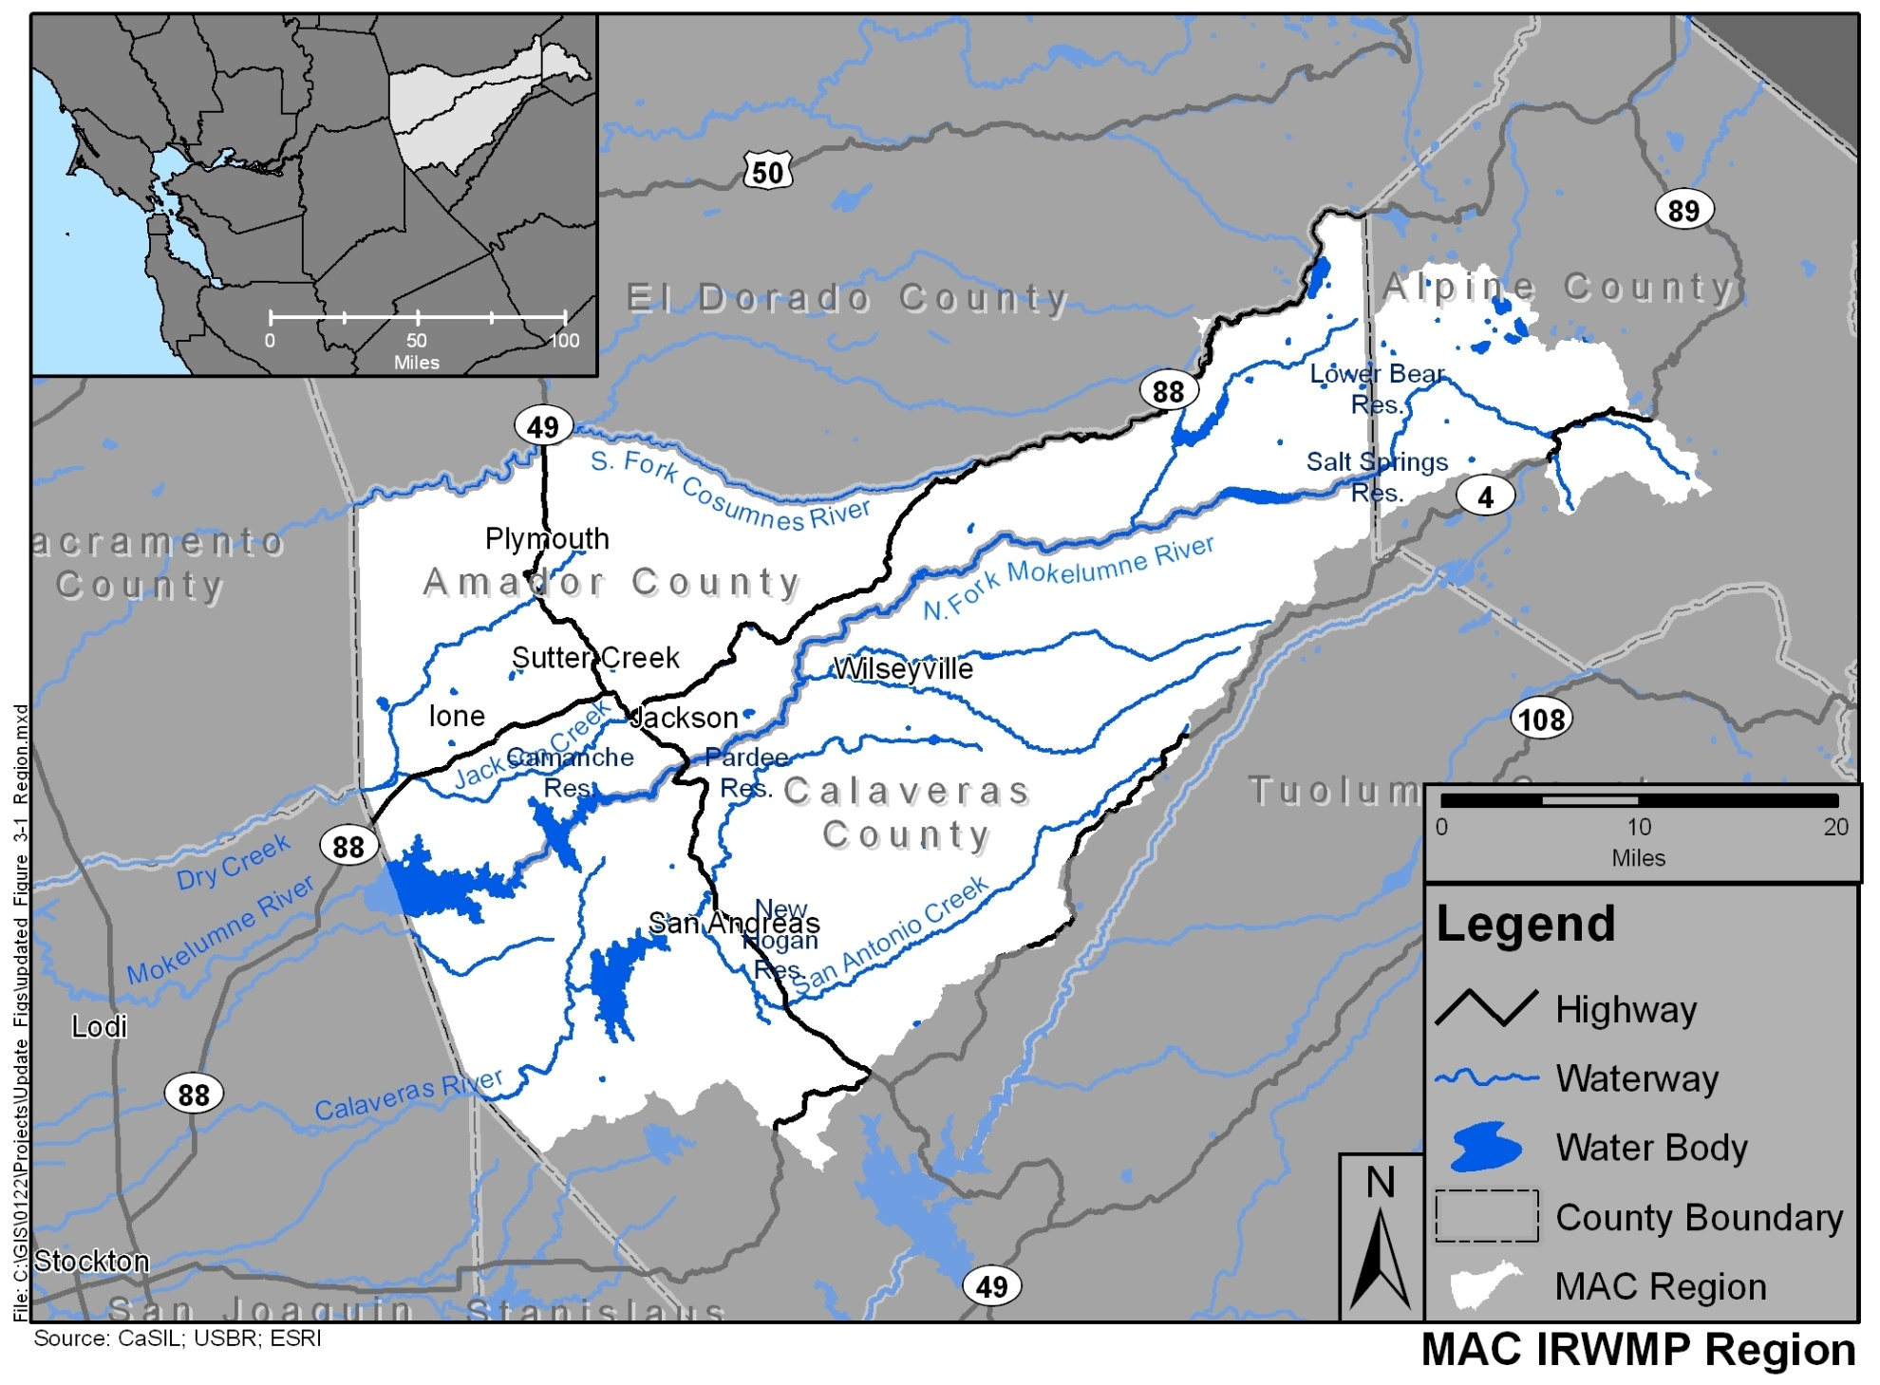
MAC Region (Approved December 2009)

Slide 9
MAC Plan Update Organization
Upper Mokelumne River Watershed Authority Board
(UMRWA)
Board Advisory Committee (BAC)
Regional Participants
Committee (RPC)
Consultant Team
General Public

Slide 10
DWR’s Proposed IRWM Guidelines and PSPs
Prop 84 IRWM Funding
Draft IRWM Guidelines and Standards
IRWM Guidelines
Implementation Grant Proposal Solicitation Package (PSP)
Planning Grant PSP
DWR Schedule

Slide 11
IRWM Guidelines/PSPs Prop 84 IRWM Funding
Prop 84 approved November 2006
$1B allocated to IRWM Program
$900M for regional programs
$100M for inter-regional programs
Regional Programs: 11 funding areas
MAC Region in San Joaquin funding area
$57M allocated to SJ funding area
Planning Grants from statewide funding pool

Slide 12
IRWM Guidelines/PSPs Prop 84 IRWM Funding (Implementation)
IMPLEMENTATION GRANT | DWR - PROPOSED
Total SJ Funding Allocation | $57M
No. of eligible regions | 4
SJ Funding Area this cycle | $6.33M
MAC region grant @ 25% allocation | $1.60M
Local match (n/a DAC projects) | 25%
Award process | Competitive w/in Funding Area

Slide 13
Funding Area Alignment
$57 Million
$900 Million
^{Central California}
^{East Contra Costa County (E)}
^{Eastern San Joaquin (E)}
^{Madera (E)}
^{Merced}
^{Mokelumne/Amador/Calaveras (E)}
^{Tuolumne-Stanislaus}
San Joaquin Funding Area
Local IRWM Regions
Statewide
Notes:
Funding is more important to some agencies
Serves as a helpful rallying tool
Is competitive and complex; thus requires right planning
While DWR allocates funding geographically, the process for securing that funding is not clear and could be competitive

Slide 14
IRWM Guidelines/PSPs Prop 84 IRWM Funding (Planning)
PLANNING GRANT | DWR - PROPOSED
Statewide funding available | $20M
Max grant award | $1M
No. eligible applicants | 46
Local match | 50%
Award process | Competitive statewide

Slide 15
DWR’s Draft IRWM Guidelines/PSPs
Basic eligibility requirements:
Applicant approved per 2009 RAP process
Consistent w/adopted IRWM plan
Urban Water Mgmt Act compliance
AB1420 compliance (BMPs)
Meter Conversion compliance
Implementation Grant eligibility:
Projects in adopted IRWM plan
Projects for DACs (critical water issues)
Leak detection/repair projects for AB1420 non-compliant urban water suppliers

Slide 16
DWR’s Draft IRWM Guidelines/PSPs (cont)
Planning Grant eligibility:
Activities to develop, update or improve IRWM plans
Tasks which address specific IRWM plan elements in detail
Plan must meet new IRWM standards

Slide 17
DWR’s Tentative IRWM Schedule
July 1 – DWR releases final Guidelines/PSPs
Aug 15 – Planning Grant applications due
Sept 1 – Implementation Grant applications due

Slide 18
Implementation Grant Application
Application steps and tentative schedule
Today – Present candidate projects to RPC for review and comment
June 18 – Authority BAC reviews/endorses projects and proposed funding amount
July 23 – Authority Board approves Implementation Grant application
Sept 1 – Implementation Grant application submitted

Slide 19
Implementation Grant Short-listed ‘Candidate Project’ Selection Criteria
Eligibility: Project in ‘06 MAC Plan; or per DWR exceptions for (a) critical DAC water need, or (b) leak detection/repair project for urban water supplier
High scoring potential:
Expected positive economic cost/benefit finding
Project readiness to proceed
Identified source of 25% funding match
Fulfills state IRWM priorities (DACs, conservation, resource stewardship, reliability, efficiency, et al)

Slide 20
Implementation Grant Application Short-listed Candidate Projects
Project Name | Eligibility Basis | Estimated Cost
Amador Leak Detection & Repair | 2006 MAC Plan | TBD
AWA Leak Detection & Repair | Rule Exception | TBD
Lake Camanche Leak Repair | Rule Exception | TBD
West Point Distribution System Replacement | 2006 MAC Plan | $4.3M
West Point Filter Installation | Rule Exception | $650,00
CCWD Leak Detection & Repair | Rule Exception | TBD

Slide 21
Planning Grant Application
Application steps and tentative schedule
Today – Solicit RPC input regarding:
Preferred level of RPC participation in MAC Plan update
Option for addressing IRCUP conflicts
June 18 – Authority BAC reviews/endorses Planning Grant application and requested funding amount
July 23 – Board approves Planning Grant application
Aug 15 – Planning Grant application submitted

Slide 22
Planning Grant Application – Optional Approaches for RPC Involvement
Meet monthly - Address 1 or 2 topics per 2 to 3 hour meeting*
Meet every other month – Address perhaps 2-4 topics per half-day meeting*
Meet quarterly – Address multiple topics in full day meeting*
(* RPC members generally expected to also review agenda materials prior to attending meetings)

Slide 23
Planning Grant Application – Task to address IRCUP Conflicts?
Question: Should the RPC work to refine/resolve conflicts associated with the IRCUP Project as a separate task associated with the MAC Plan update process?
If ‘yes’, a task will be included in the Planning Grant application to provide funding for facilitating the RPC’s consideration of the IRCUP project and its associated impacts and conflicts w/in the MAC Region.

Slide 24
Adjourn and Next Steps
Draft RPC meeting #2 minutes distributed for review
Implementation and Planning Grant applications to be prepared and submitted
Date for next RPC meeting to be determined based on need for discussion/input of substantive topic(s)
Periodic email notes to be sent to update RPC on key developments

